Slide 1


21 April 2026
Universo Operations Account Management
IOW Study Tour

Slide 2

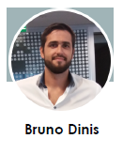











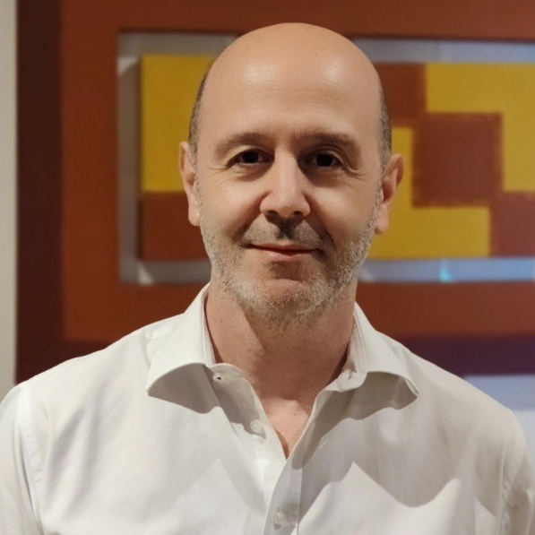
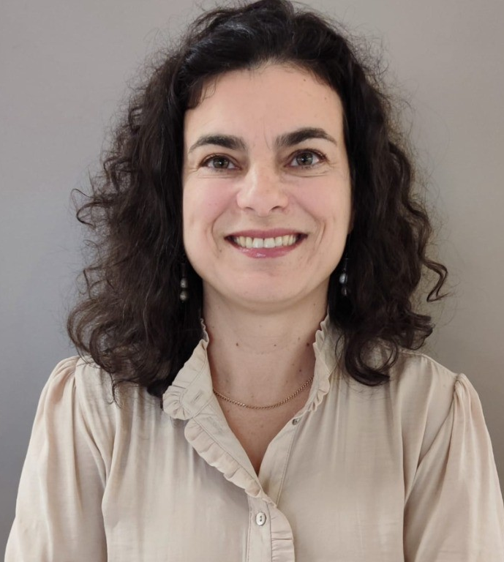

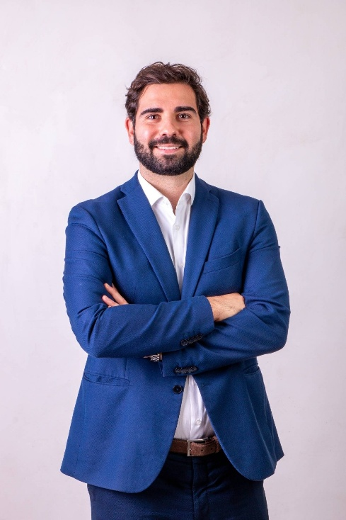


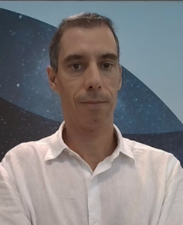



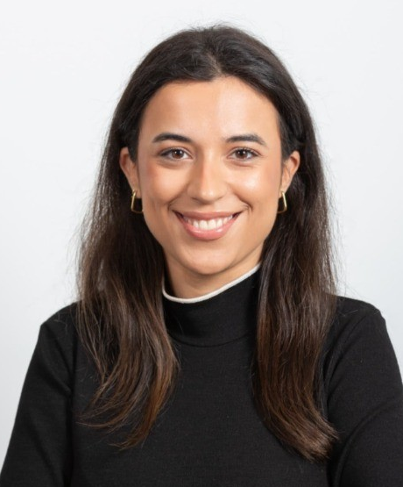
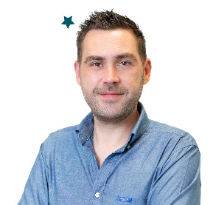


A diversified team, combining expertise of both companies and varied past experiences with responsabilities across lifecycle
5
Application Processing
Accounts Management
Transactions Management
1
2
3
4
7
9
5
6
8
4
7
Client & Account Creation
Document Validation
Card Issuing & Activation
Authorization & Cashback
Statement processing
Cancelation
Retention
Fraud & Chargeback
Transaction integration
Billing processing
Alexandre
Matos
Natália
Jesus
Tiago
Vilaverde
Paullus
Lima
Vitor
Carneiro
Ana
Nogueira
Vera
Ribeiro
Pedro
Santos
Tiago
Nijo
Inês
Santos
Elsa
Lourenço
2

Slide 3
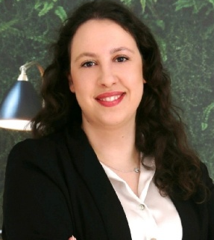
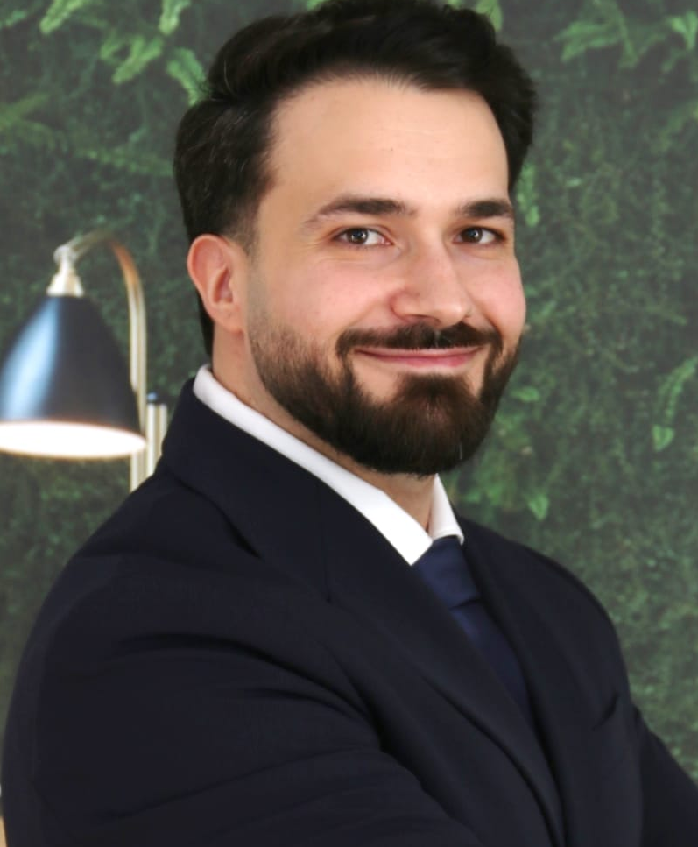

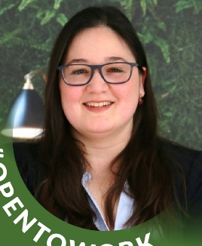
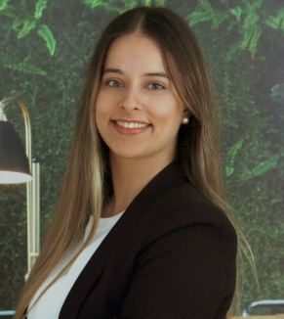
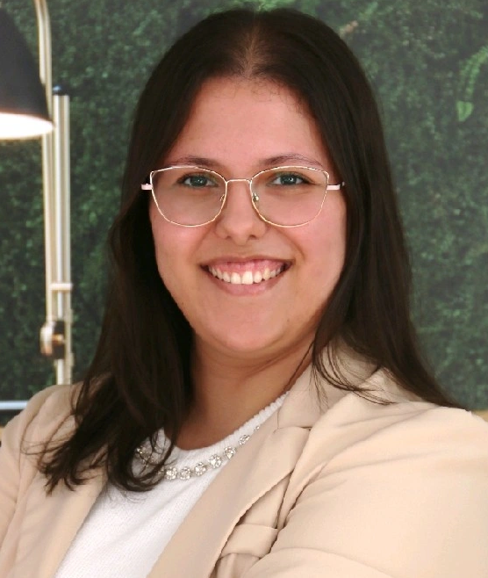

Operations Account Area
1
2
3
4
Card Issuing & Activation
Authorization & Cashback
Vitor Carneiro
Statement & Billing
Cancelation &
Retention
Vera Ribeiro
Paullus Lima
Ana Nogueira
Tiago Vilaverde
Account Manager
Business Partner Operator
Daniel Almeida
Miguel Teixeira
Catarina Nunes
Mariana Magalhães
Cátia Ribeiro
Ana Sofia
Cruz
3
3

Slide 4
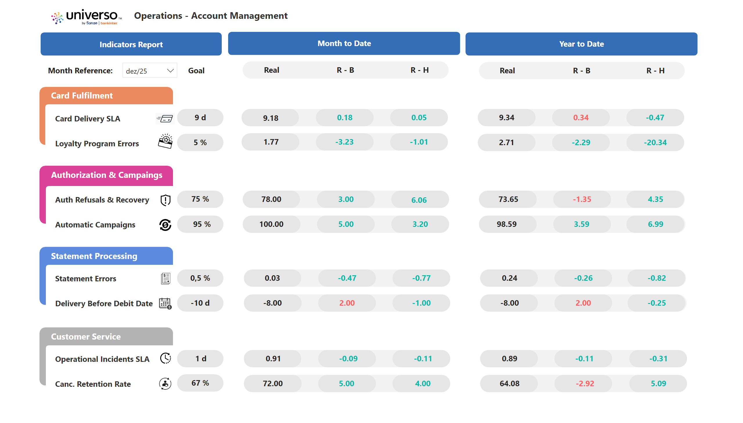

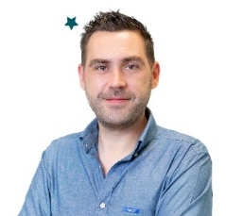

Power BI
4

Slide 5
21 April 2026
Universo Operations
Account Management
Performance & Goals

Slide 6

CARD FULLFILMENT
For 2025, the goal was that more than 90% of customers receive a card in 9 days.
JV with Bakinter, at end of 2023, caused some challenges! But we never give up…
Fulfillment and Delivery Process
Performance on fulfillment by partner (calendar days)
24
Goal for 2018
21
20
16
Goal for 2019-2020
14
14
Goal for 2021-2023
11
10
10
10
9
9
Goal for 2024-2025
9
IOW implementation
BNP decomission
JV with Bankinter
% SLA per goal | 55% | 91% | 78% | 89% | 80% | 86% | 90% | 74% | 87%
6

Slide 7
CASHBACK CONTROL
For 2025, the goal was to be above 95% in cashback and in without interests campaigns.
JV with Bakinter, at end of 2023, caused some challenges! But we never give up…
Transactions attrition: cash back issues
% Automatic Cashback (#)
Goal for 2023-2025
95
Goal for 2022
90
Goal for 2021
85
Goal for 2019-2020
80
IOW implementation
BNP decomission
JV with Bankinter
7

Slide 8

STATEMENT PROCESSING
For 2025, the goal was to reduce errors to 0,5%, keeping digital statements in 93%.
JV with Bakinter, at end of 2023, caused some challenges! But we never give up…
Billing Evolution
% statements by channel expedition
615
639
652
631
619
471
517
528
430
Goal for 2023
2,0%
Goal for 2024
80%
1,0%
64%
Goal for 2025
0,5%
IOW implementation
BNP decomission
JV with Bankinter
Goal for 2018-2022
% digital statements | 64% | 80% | 85% | 90% | 90% | 92% | 92% | 93% | 93%
8

Slide 9
Business Process Operator
For 2025, the goal was to be below 1 day to close a process, with less than 1% recurrence.
JV with Bakinter, at end of 2023, caused some challenges! But we never give up…
Operational Incidents Process
Total salesforce cases resolved per month
Goal for 2020-2021
3
Goal for 2022-2023
2
Goal for 2024-2025
1
IOW implementation
BNP decomission
JV with Bankinter
% recurrence | 21% | 14% | 12% | 9% | 5% | 2% | 1%
9

Slide 10
API ERRORS
For 2025, the goal was to be below 25 errors in data integration.
JV with Bakinter, at end of 2023, caused some challenges! But we never give up…
Batch files/api error handling
Number of accounts with errors on batch files/api’s exported (#)
5.294
Goal for 2018-2019
2.000
1.680
1.303
980
Goal for 2020-2021
1.000
835
Goal for 2022-2023
100
129
50
18
16
Goal for 2024-2025
25
IOW implementation
BNP decomission
JV with Bankinter
10

Slide 11
21 April 2026
Universo Operations
Account Management
2020 & Covid Impact

Slide 12
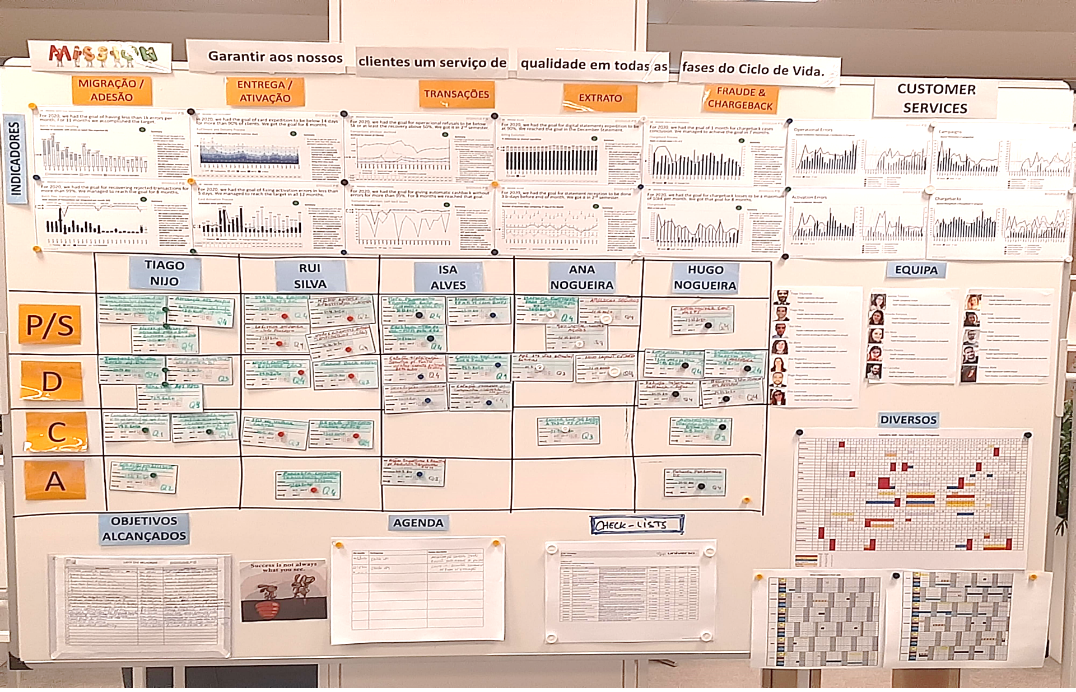
MIRO
12

Slide 13


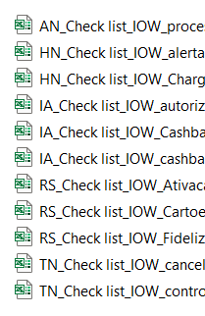
MIRO
Mapeamento de tarefas
Checklist de
tarefas por função
Podemos ir de férias!
13

